Slide 1
NDRRMC Monitoring System
Balcena | Carpio | Haboc | Salazar

Slide 2
Overview
Description
Objectives
Scope
Data Warehousing
BI Tool
Prototype

Slide 3
Problems
Lack of public awareness or the threats and impacts of all types of hazards
Lack of preventive technical DRRM mechanisms
Lack of coordination and communication among DRMM stakeholders
Assessment of Disaster Risk Reduction and Management (DRRM) at the Local Level

Slide 4
Description
Tracks relevant data from different NDRRMC independent systems (e.g. Logistics, Inventory, Procurement, etc.)
NDRRMC admin sends disaster advisory alert
LGU admins receive a notification about the upcoming disaster details
LGU admins evaluate and identify needed supplies
Improves the planning process, correcting problems and obviating similar problems in the future

Slide 5
Objectives
General Objectives
The NDRRMC Monitoring System is a system that can help NDRRMC to quickly give advisory to Local Government Units (LGU)
LGUs can easily identify and request for supplies

Slide 6
Scope
Registration of account for Local Government Unit (LGU) admin
NDRRMC admin send advisory to LGU admin
LGU admin requests for supplies
Monitoring System produces summary reports using Business Intelligence (BI) Tool

Slide 7
Data Warehousing

Slide 8
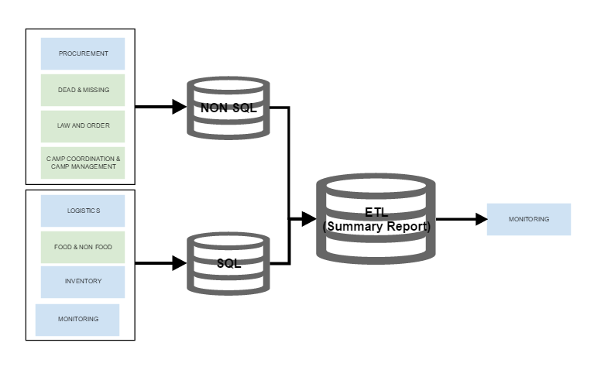

Slide 9
Business Intelligence (BI) Tool
IBM Watson
Pentaho

Slide 10
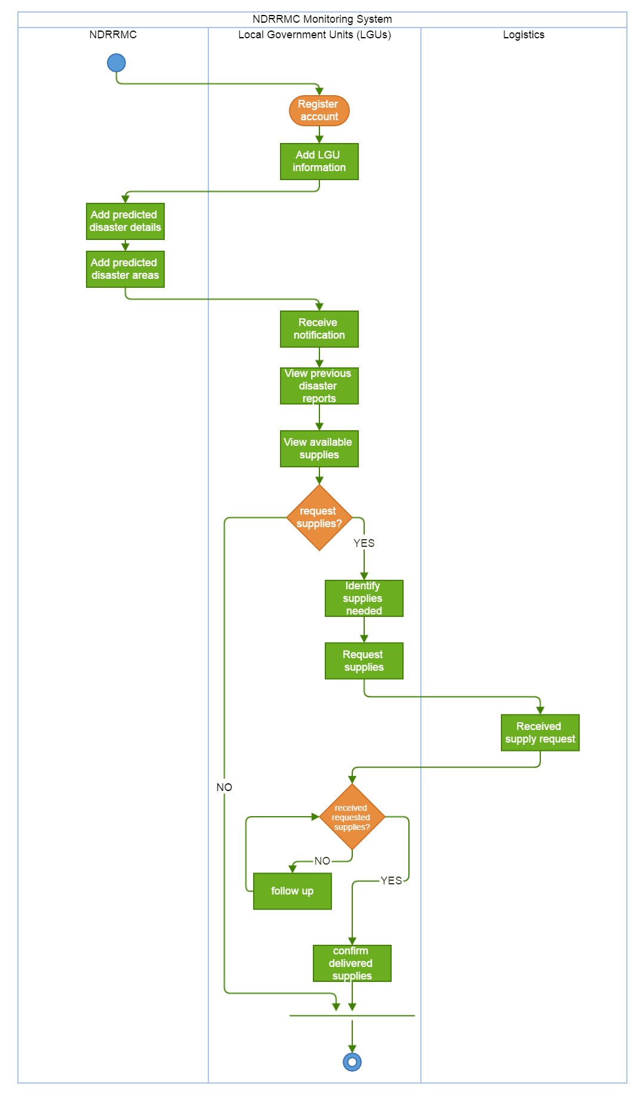

Slide 11
